Slide 1
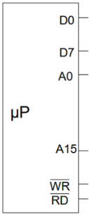

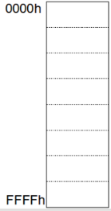

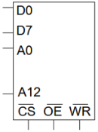
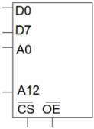











$$000x…x$$
$$001x…x$$
$$OR$$
$$010x…x$$
$$011x…x$$
A12 A13
A14
$$OR$$
$$100x…x$$
$$101x…x$$
$$110x…x$$
$$OR$$
$$111x…x$$

Slide 2










1
$$OR$$
2
$$000x…x$$
A12 A13
A14
1
$$001x…x$$
$$OR$$
1
$$010x…x$$
1
$$011x…x$$
$$OR$$
$$100x…x$$
2
$$101x…x$$
2
$$110x…x$$
2
$$111x…x$$

